Slide 1
Welcome to our Presentation
Firti Gari (Project)

Slide 2
Team Pie
Tanzim Hasan _ 2018200000038
Sourov Das Tomal _ 2018200000034
Mahfuza Khandokar Rifath _ 2018200000028
Mohammad Mehadi Hasan _ 2018200000005

Slide 3
Project Instructor
AKM Ahsanul Hoque,
Adjunct Professor & Consultant
CSE3036.2 & Information System & Software Engineering Lab

Slide 4
Summary :
Basic Concept
Our Goal

Slide 5
Introduction :
Theme of this project
Why Should we use FIRTI GARI
Common Transport

Slide 6
Background of the Study:
The main concept of this project
reasonable cost.

Slide 7
Objectives:
Primary objective:
Secondary objective:

Slide 8
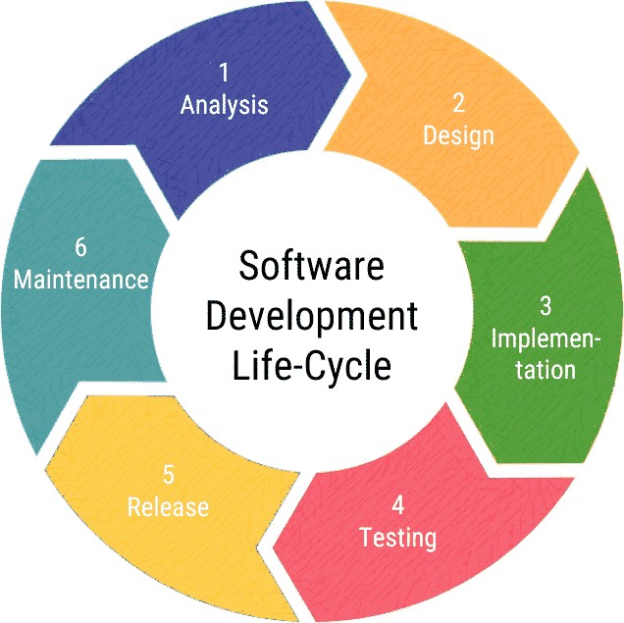
Modeling: (agile methods)

Slide 9
Communication :
Survey-

Slide 10
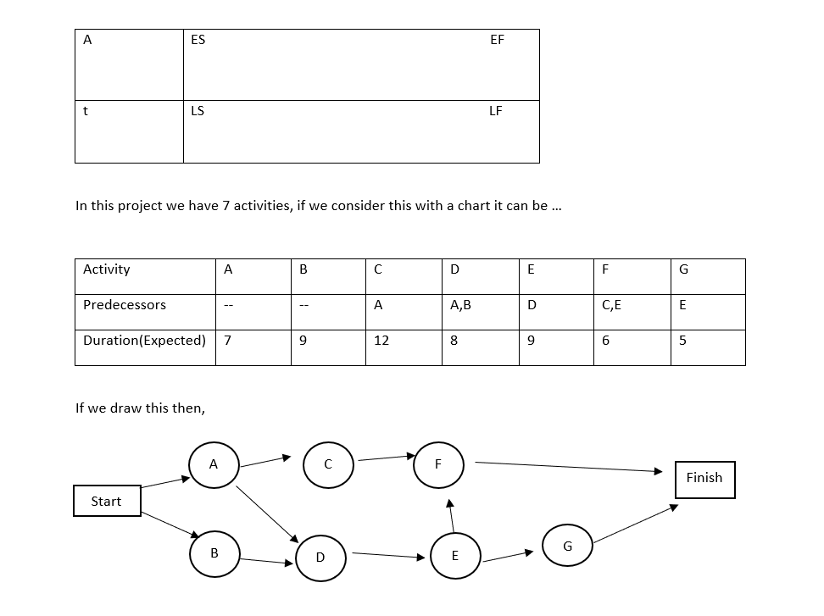
Planning: a. PERT:

Slide 11
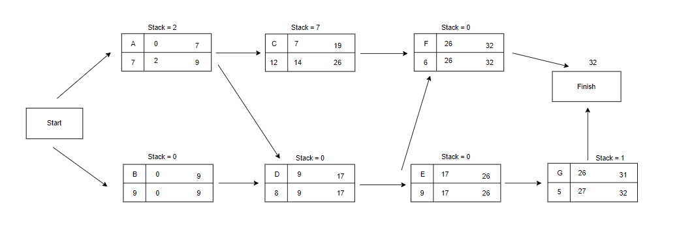
b. CPM:
Now we can calculate stack
Stack = LS – ES or LG – EG
Stack = 0

Slide 12
Project Estimations:
Information domain value | Opt. | Likely | Pess. | Es. count | Weight | FP count
1.Name of external input | 2 | 2 | 3 | 3 | 4 | 9
2.Name of external output | 1 | 2 | 3 | 2 | 5 | 10
3.Name of external inquiries | 2 | 1 | 2 | 1 | 5 | 7
4.Name of internal logical file | 6 | 3 | 7 | 4 | 10 | 42
5.Name of external interface files | 2 | 2 | 3 | 2 | 7 | 15
Unadjusted FP count |  |  |  |  |  | 83

Slide 13
FP = UFP × CAF UFP = Unadjusted Function Point CAF = Complexity Adjusted Function point Complexity Adjustment Factor is calculated using 14 aspects of processing complexity and these 14 questions answered on a scale of 0-5 0 - No Influences or No Important 1 - Incidental 2 - Moderate 3 - Average 4 - Significant

Slide 14
Factor Value Backup and recovery 4 Date communication 1 Distributed processing 5 Performance critical 4 Existing operating 3 Online data entry 5 Input transaction- over multiple screen 5 Master files- update online 4 Infor domain- value complex 3 Internal processing 5 Code design for reuse 4 Convention/Installation 0 Multiple Installation 3 Application design 5 51
Value adjustment factor = 1.65+0.01×£f1
FP estimation = w = 97
Let,
Average production Y = 6.5 FP\pm
Labor rate = Y = $6,500 per month
So,
Cost per FP = Z = Y/X = 6500/6.5
= $1000(approx)
Total estimate project cost = w*z
= 97*1000
= $97000(approx)

Slide 15
g. Risk Analysis
Risk identification.
Risk analysis.
Risk evaluation.
Risk | Description
Generic Risk | Generic threats across all projects. For example, requirements change, loss of team members, loss of funding.
Product- Specific risk | High level risks associated with the type of product being developed. For example, availability of testing resources.
Project risks | Affect project schedule or resources
Product risks | Affect quality or performance of software
Business risks | Affect the viability of the software.

Slide 16
Project budget:
Cost-Benefit Analysis :
Tangible-Cost
Intangible-Cost
If the system is not working as we expected, then the reputation of the organization is diminishing day by day.

Slide 17
Benefits:
Tangible-Benefits :
People may use our system widely and it will help us economically. If we increase the speed of processing, we will get more benefits.
Intangible-Benefits :
The reputation of the organization will increase. We can also save our resources if the project is finish before the deadline.

Slide 18
Feasibility Study:
operational
Economical
Technical Feasibility

Slide 19
a. Project Features:
Register : The rider give his/her full information(name, id ,address etc) as we have to know who is driving
Location: As our main roll is rider so rider need to enter his/her location where he end his rid And enroll his destination area
Day: Notify riders Returning day.
Time : Rider need to set his/her arriving time and also return time
Login : Now passenger first need to open the app as passenger also need to know when rider will finish his rid and which day he come and also the time
pay bill : Reasonable cost

Slide 20
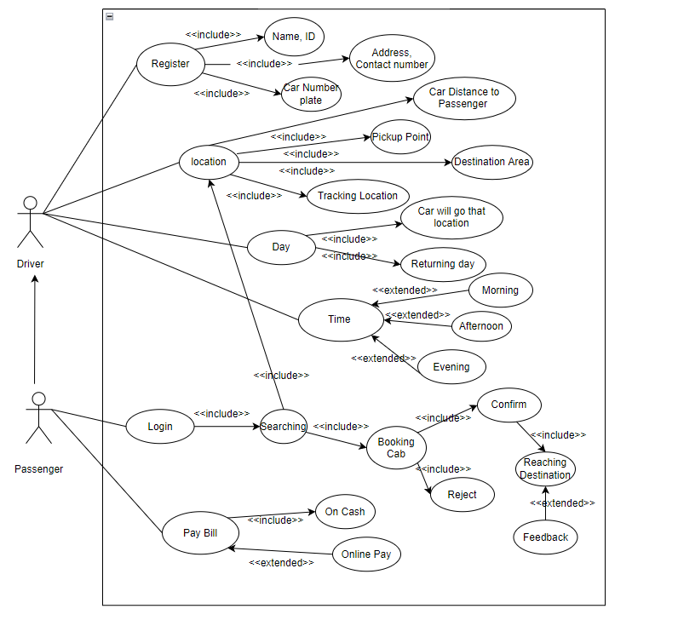
Use Case Diagram:

Slide 21
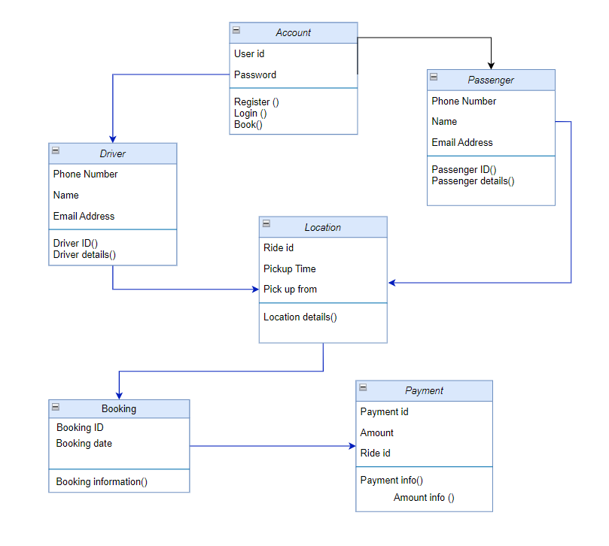
d. Class Diagram i. CRC

Slide 22
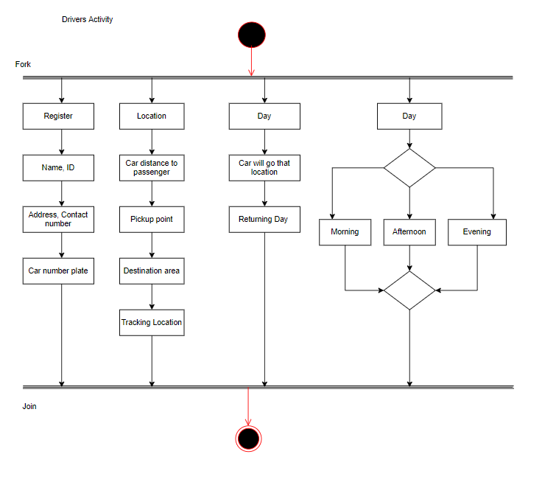
f. Activity Diagram: Driver Activity:

Slide 23
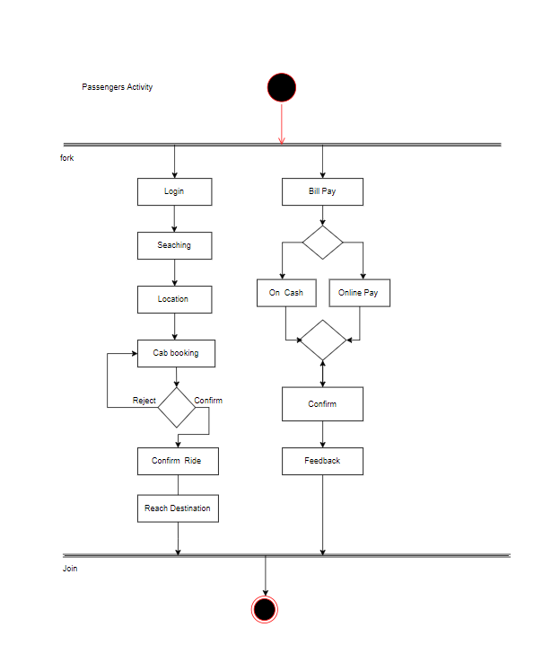
Passenger Activity

Slide 24
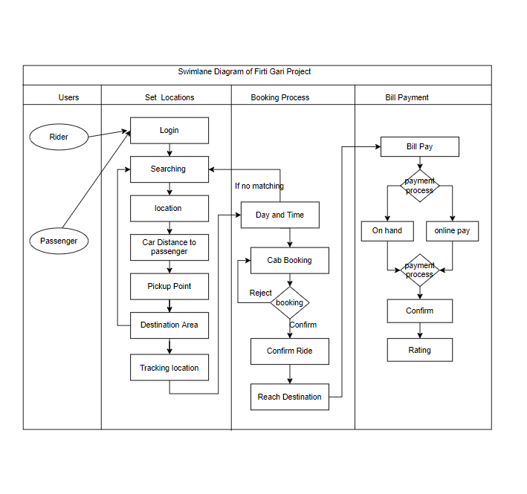
g. Swimlane Diagram:

Slide 25
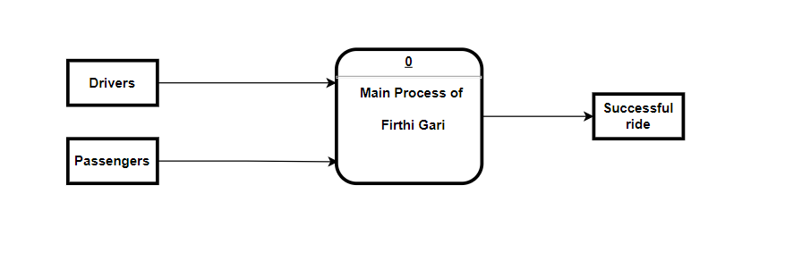
i. Data flow diagram: Context Diagram

Slide 26
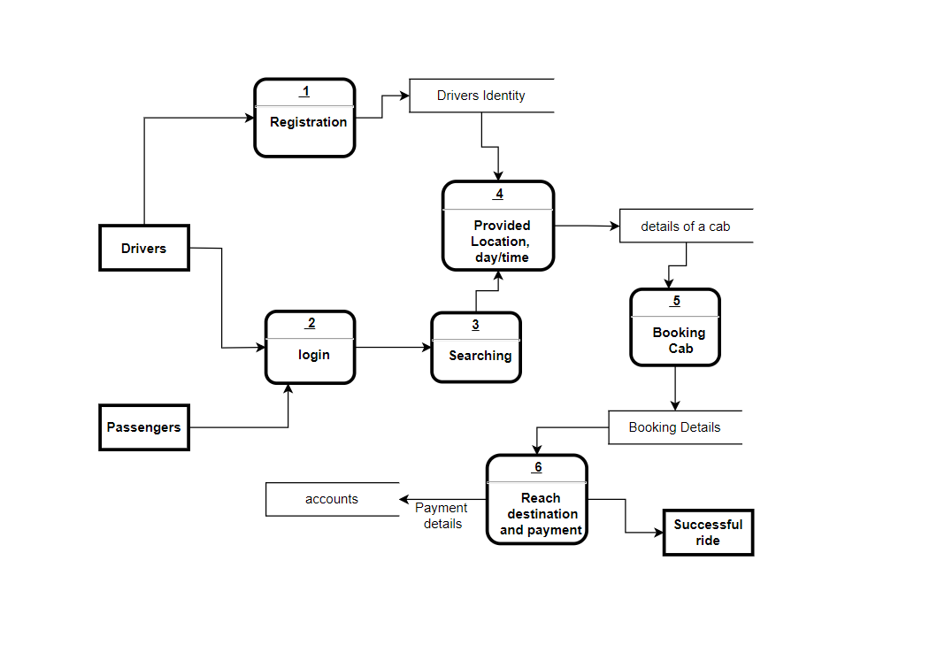
0 Level Diagram:

Slide 27
SWOT Analysis of your project
Strengths | Weakness | Opportunities | Threats
Capital stock: We have established and maintained a strong capital base. Marketing: Aggressive and focused marketing campaign with clear goals and strategy. Management team: Good team of people. | Quick Expansion: There are a lot of new hires to train and organize structures to learn. New: Not well known in market. Employee: Increasing employee cost. Office: No office presence. | Issue: We have quick access in customer issue. Investment: Increase investment quality. Target and improve our system. Community: we have strong, loyal & community. Profit: Ability to find more profit. | Brand: Brand impersonality and mediocre engagement Competition: Global competition is challenging. Customer demand: it’s quite challenging to ensure quality product as technology & customer demand change rapidly. Increate operation cost

Slide 28
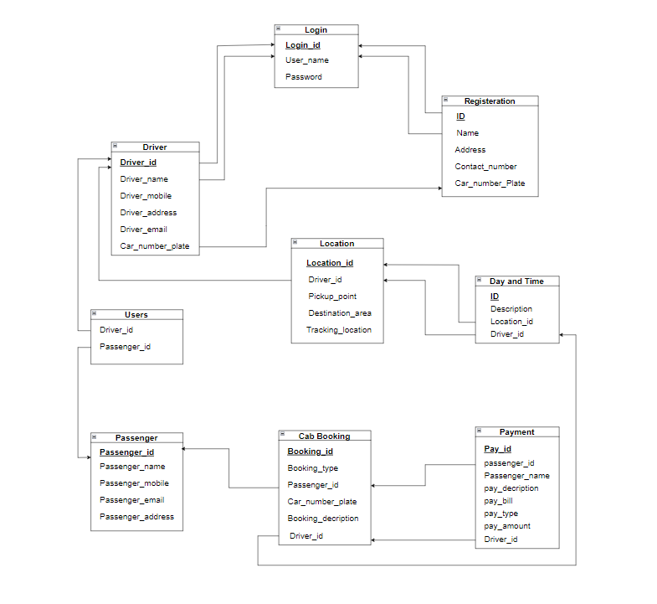
m. Schema Diagram:

Slide 29
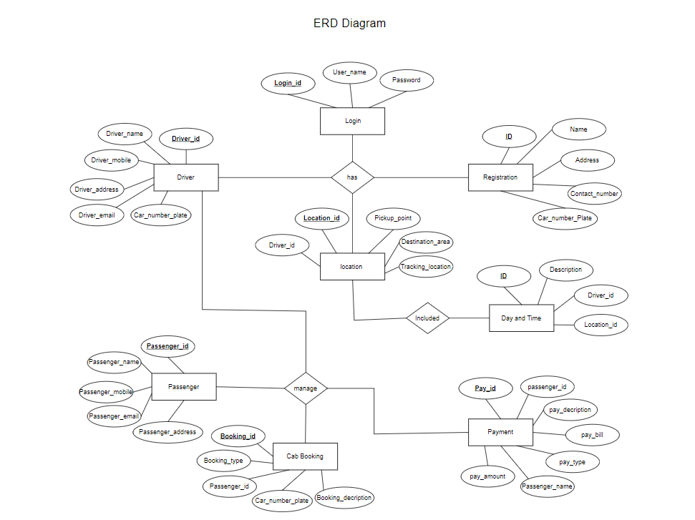
p. ERD

Slide 30
4. Construction:
Language:
In this project we use JAVA (For app)
For our website we use (Frontend) HTML, CSS, BOOTSTRAP, Js (React)
For backend we use node Js, we use MYSQL for Database.
Testing Strategy

Slide 31
Testing techniques:
We go through with this technique in our project
Unit testing.
Integration testing.
Acceptance testing
Performance testing
Security testing
Usability testing

Slide 32
A. Deployment:
The deployment process flow consists of 5 steps:
Planning
development
testing
deploying
monitoring
AMC (Annual Maintenance Contract)
Support and Maintenance

Slide 33
6.Learning Experiences: 7. Conclusion:

Slide 34
Thank You

